Slide 2
Objectives
Explain geolocation and its use in HTML5
Explain the Google Maps API
Explain the drag-and-drop operations in HTML5
Explain the concept of Application Cache

Slide 3
Geolocation 1-2
Geolocation in computing terminology determines the current location of a user on the devices.
The location of the user is represented as a single point that comprises two components: latitude and longitude.
Following figure shows the representation of latitude and longitude with respect to a location on the globe.

Slide 4
Geolocation 2-2
Devices can determine the information about the location based on the different sources are as follows:
Global Positioning System (GPS)
User Input
GPS is a satellite navigation system that provides information about the location on any part of the globe.
It is a software tool which can be used on any device requesting for location information.
The GPS system is maintained by the government of the United States.
IP Address
GSM/CDMA Cell IDs
WiFi and Bluetooth MAC address
Location information can be derived from IP Address which is assigned to devices, such as desktops, printers, and so on connected on a network.
These are used by the cell phones.
These are used by devices that have wireless network connection.
The information retrieved by the tool is based on the data provided by the user. For example, a zip code.

Slide 5
Geolocation API
In HTML5, the Geolocation API is a specification by W3C for providing a consistent way to develop location-aware Web applications.
The Geolocation API provides a high-level interface to retrieve location information related to the hosting devices.
The interface hides the details, such as how the information is gathered or which methods were used to retrieve the information.
The object that holds implementation of the Geolocation API is the Geolocation object.
This object is used in JavaScript to retrieve the geographic information about the devices programmatically.
The Geolocation API is supported on most of the modern browsers available on desktop and mobile phones.

Slide 6
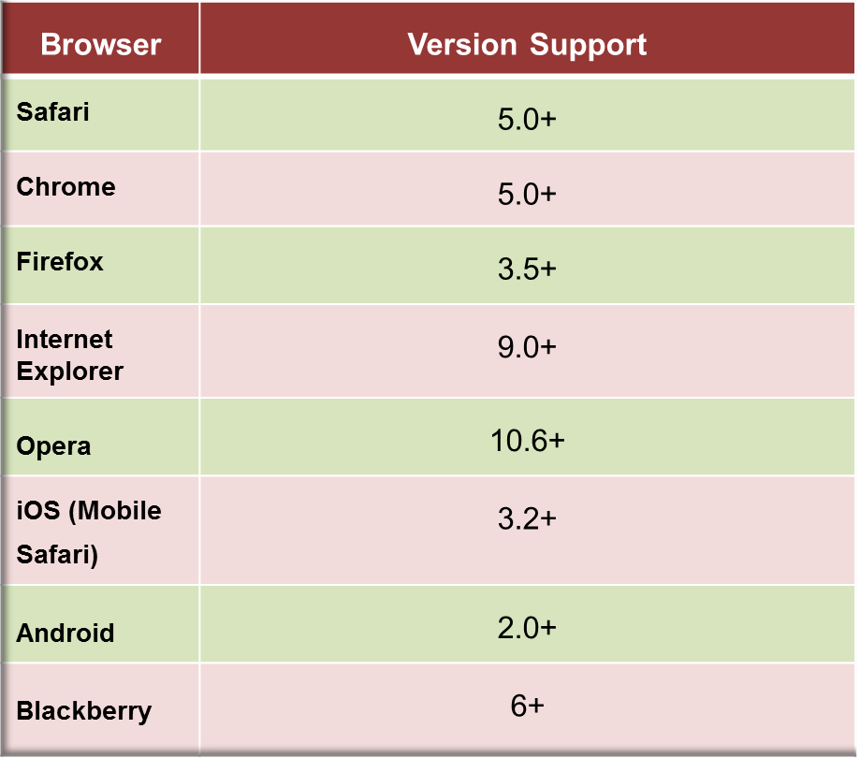
Implementing Geolocation Object
The Geolocation object is available as a new property of the navigator object.
var geolocation = window.navigator.geolocation;

Slide 7
Geolocation Methods
The geolocation object provides three methods to determine the current position of the user: getCurrentPosition(), watchPositon(), clearWatch().
The PositionError object holds information related to errors occurred while finding the geographic location of the user.
Following table lists the properties of PositionError object.
Property
code
message
1 | PERMISSION_DENIED
2 | POSITION_UNAVAILABLE
3 | TIMEOUT

Slide 8
PositionOptions Object
PositionOptions object is an optional third parameter passed to the getCurrentPosition() method.
Following table lists the attributes of PositionOptions object.
^{Attribute} | ^{Description}
enableHighAccuracy | Indicates that the application wants to receive the most accurate results for geolocation. The default value of the attribute is false.
maximumAge | Obtains the cached position object whose age is less than the specified maximumAge limit (in milliseconds). If age limit is set to 0, then the application must obtain a new position object.
timeout | Indicates the maximum time length (in milliseconds) for which the application can wait to obtain the position object.

Slide 9
Google Maps API
Google Maps API is used to display locations on a map based on the values of their coordinates: latitude and longitude.
It contains a Map object which is instantiated and displayed on a Web page.
It must be configured in JavaScript, before it can be referenced further on the page.
Following syntax shows the configuration of Google Maps API in JavaScript.
<script src=”http://maps.google.com/maps/api/js?sensor=false”>
</script>
^{where,}
src: Is the URL of Google Maps API.
sensor: Parameter sent with the URL. It indicates whether application uses any sensor such as GPS system.

Slide 10
Tracking User’s Location
The Geolocation object is used by the Google Maps API to display the geolocation information in the applications.

Slide 11


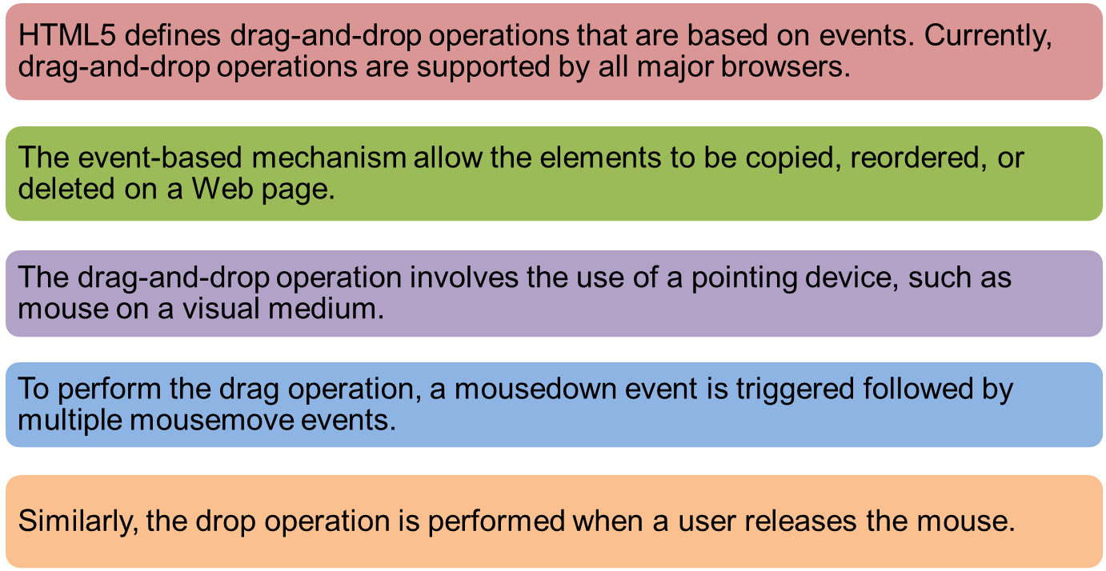
Drag and Drop

Slide 12
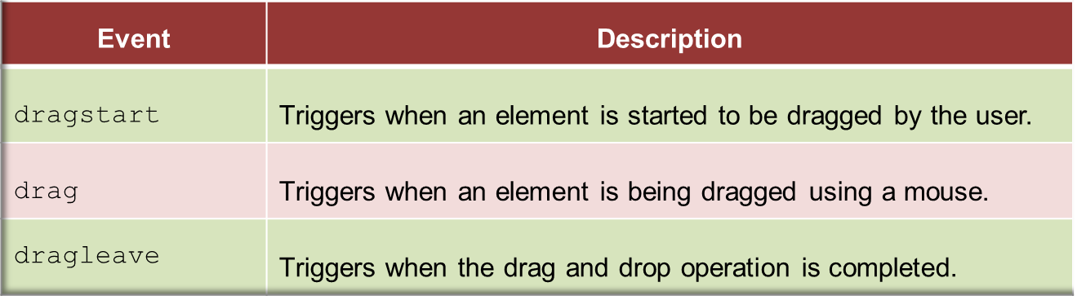
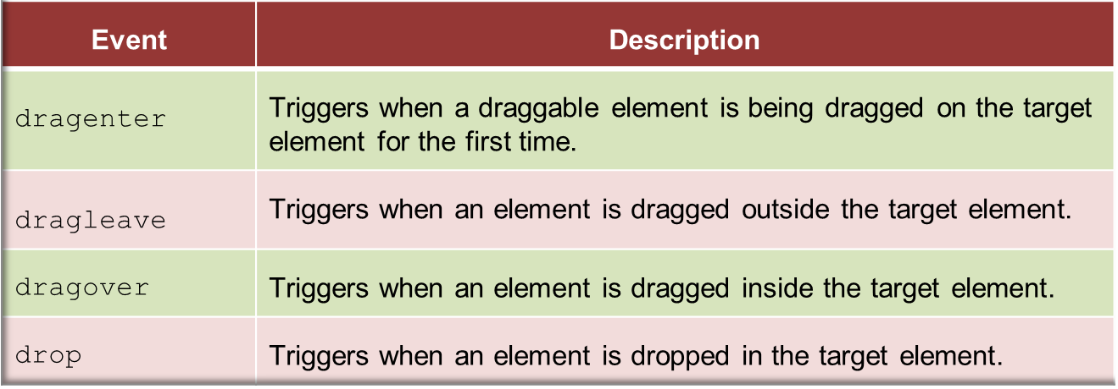
Drag – Drop Events
During various stages of the drag-and-drop operation, a number of events are fired.
These events are mouse-based events.
Following table lists the various events triggered during the drag operation.

Slide 13
Offline Web Applications API
HTML5 supports offline Web applications that allow a user to work with them without being online.
The offline Web applications works by saving all the Web pages locally on the user’s system.
This concept is also known as Application Cache.
The Application Cache enables all resources, such as HTML, JavaScript, images, and CSS pages of an Web application to be stored locally on the system.
Following are the steps that can be taken to cache resources locally on the system.
1. Create a manifest file to define the resources that need to be saved.
2. Reference the manifest file in each Web page designed to use cached resources.

Slide 14
Creating a Manifest File 1-2
The manifest file is a text file that defines the caching behavior for resources used by the Web page.
The file should be saved with the .manifest extension.
The Code Snippet demonstrates creation of a manifest file.
CACHE:
# Defines resources to be cached.
check.js
styles.css
images/figure1.jpg
FALLBACK:
# Defines resources to be used if non-cached resources
# cannot be downloaded
Other_images/ figure2.png
NETWORK:
# Defines resources that will not be cached.
figure3.png

Slide 15
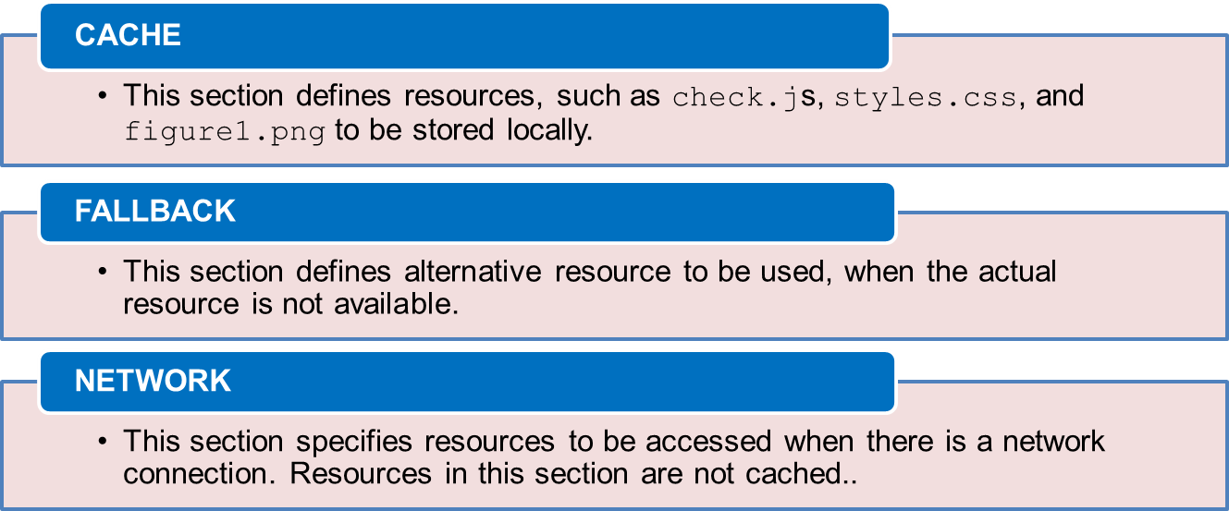
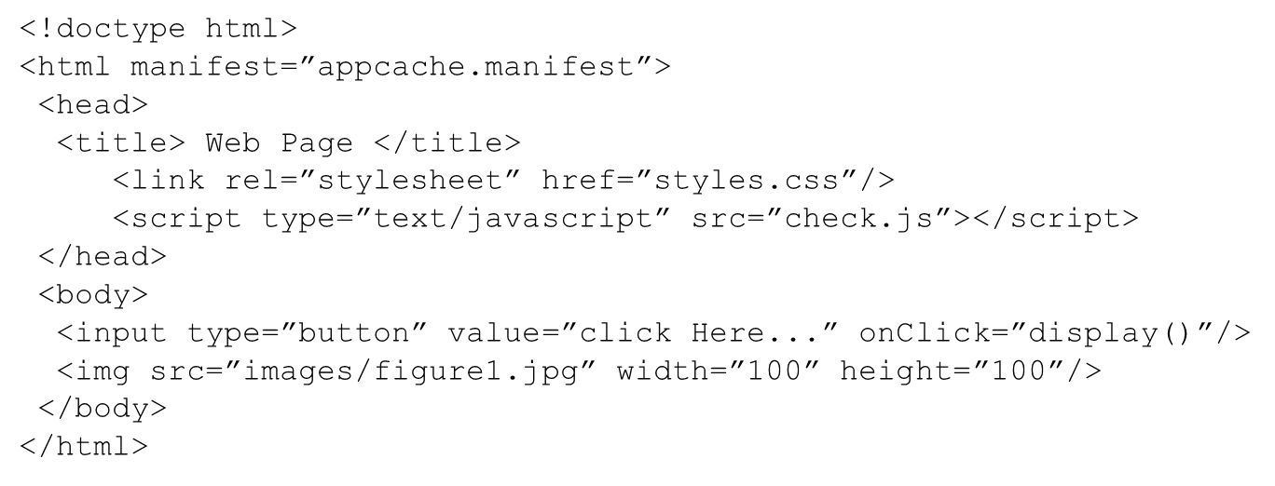
Creating a Manifest File 2-2
Following are the sections defined in the .manifest file.

Slide 16
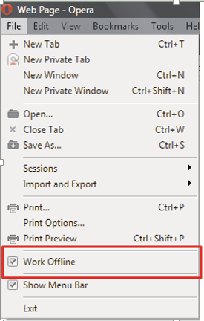
Declaring a Manifest
The benefit of Application Cache is that it improves the performance of a Web page by reducing the number of requests made to the Web server.
The Web server hosts the Web application to be accessed on the network.
Following figure shows how to enable the Work Offline mode in Opera browser, it enables to cache the resources of the Web application pages locally.

Slide 17
Summary
Geolocation determines the current location of a user on devices.
The location is represented as a single point on a map that comprises two components: latitude and longitude.
The Goelocation API is a specification provided by the W3C which provides a consistent way to develop location-aware Web applications.
Google Maps API is used to display the user’s location on the map.
The object of type Map is created in JavaScript, before it can be referenced in an HTML document.
The drag-and-drop operations defines an event-based mechanism using which elements on a Web page can be copied, reordered, or deleted.
HTML5 supports offline Web applications that allow a user to work with them without being online.

